Slide 1
Smart Career Guidance & Recruitment System
AI-powered Career Matchmaking and Recruitment Assistant

Slide 2
Problem Statement
Students/job seekers struggle to identify the most suitable career paths.
Recruiters manually read resumes → slow, inefficient, biased.
Skills gap between what candidates offer vs. what employers demand.

Slide 3
Project Objective
Build an AI-powered system that:
Reads & understands CVs (skills, experience).
Understands job descriptions & skill requirements.
Matches people with the most suitable careers instantly & accurately.

Slide 4
System Workflow Overview
Input CV (TXT file).
Data cleaning & skill extraction.
Machine Learning model predicts best specializations.
Output → Ranked career recommendations + confidence scores.

Slide 5
Step 1: Understanding the Person Uses NLP to extract skills from CVs.
Example: "Python, SQL, Project Management, Communication.“
Step 2: Understanding the Jobs System analyzes thousands of job descriptions.
Extracts required skills for roles like Data Scientist, Software Engineer, Product Manager.
Step 3: Making the Match ML compares CV skills with job requirements.
Outputs top career matches.
Also identifies missing skills for career improvement.

Slide 6
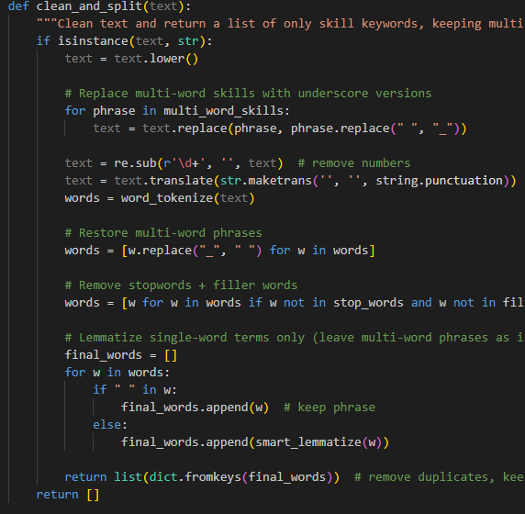
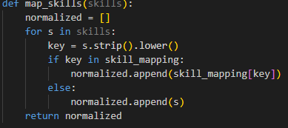
Data Cleaning & Preparation
Text normalization (lowercase, remove stopwords).
Skill standardization (mapping variations → canonical form).
Lemmatization (running → run).
Multi-word detection ("machine learning" kept as one skill).
Output: clean columns → resume_skills_mapped, experience_needed_skills_mapped.

Slide 7
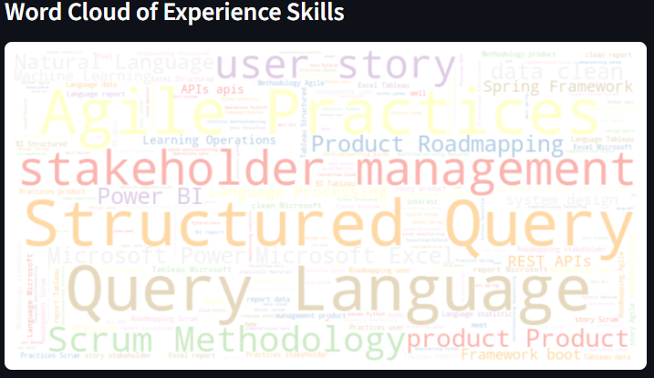
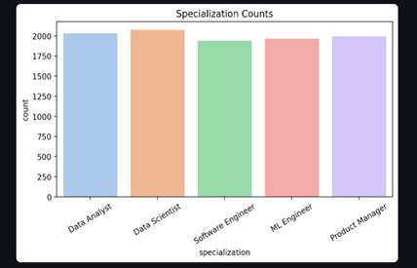
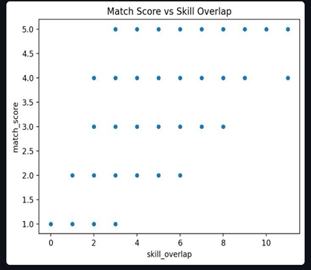
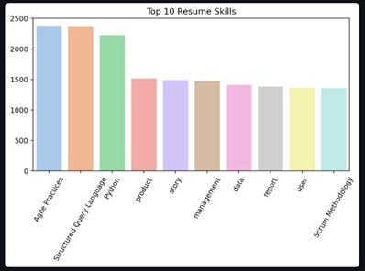
Data Visualizations (Examples)
Scatter plot: Match Score vs. Skill Overlap.
Bar charts: Top 10 Resume Skills & Top 10 Job Requirement Skills.
Specialization distribution.
Match Score histogram.

Slide 8
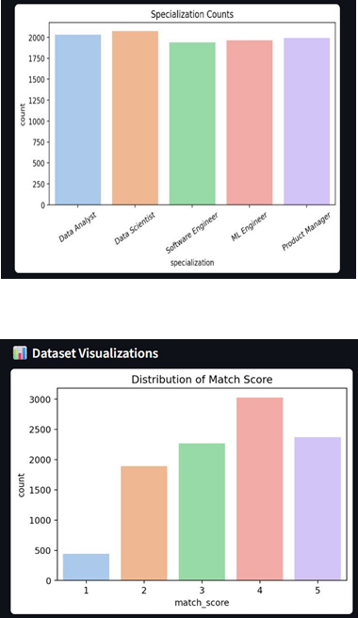
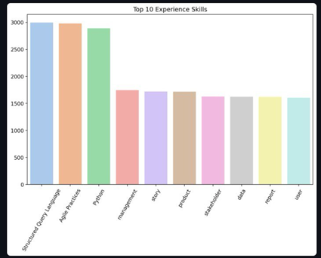
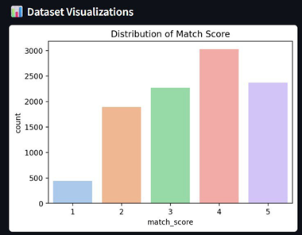
Visualization Insights
Skill overlap strongly predicts job match.
Common candidate skills: Python, SQL, Communication.
High employer demand for cloud computing → skills gap identified.
Most roles balanced, but some job titles dominate dataset.

Slide 9
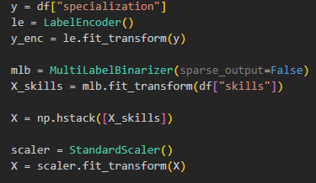
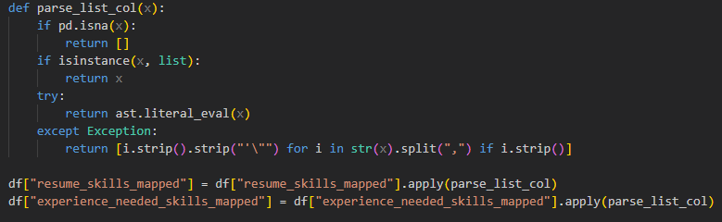
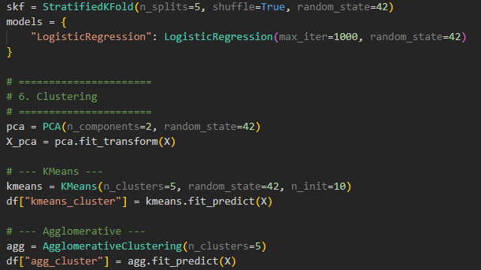
Machine Learning Process
Data encoding:
LabelEncoder → job specializations.
MultiLabelBinarizer → skills to binary features.
StandardScaler → normalize features.
Model training: Logistic Regression + Cross Validation.
Optional: clustering (KMeans) to group similar resumes.

Slide 10
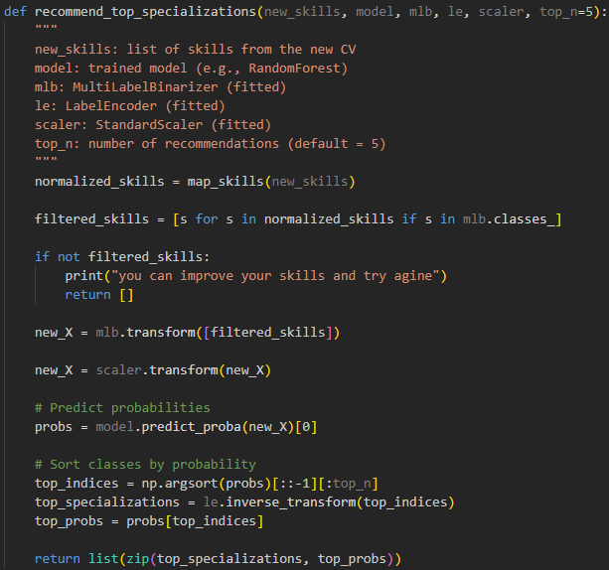
Recommendation Engine
Input: user CV → cleaned & standardized.
Model predicts top 5 job specializations.
Output: ranked list + confidence scores (e.g., 57.3%).
Stored as .pkl model files for deployment.

Slide 11
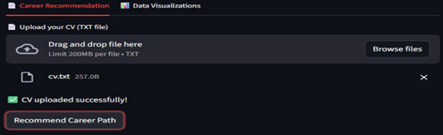
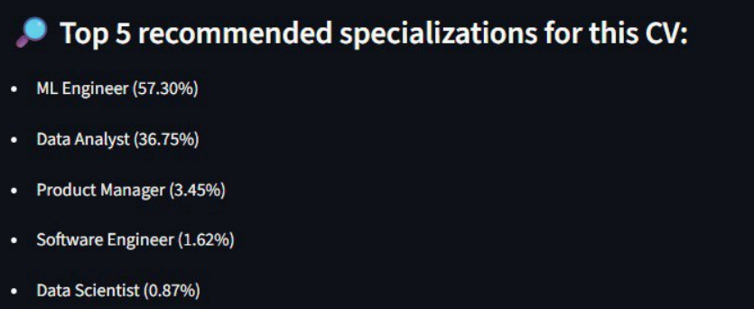
Deployment Interface (Streamlit App)
Upload CV (TXT).
Click "Get Career Recommendations".
Results: ranked job roles + probabilities.
Clean, user-friendly design.

Slide 12
Key Benefits
Automated & scalable career guidance.
Data-driven (not guesswork).
Personalized recommendations.
Identifies skill gaps for upskilling.
Ready for integration into career platforms, job portals, universities.

Slide 13
Conclusion & Future Work
Conclusion: AI + NLP + ML can revolutionize recruitment & career counseling.
Future Work:
Support multiple CV formats (PDF, DOCX).
Integrate real-time job postings.
Add recommendation system for courses to learn missing skills.

Slide 14
Team Name
Rowan Kamal Fayad
Salsabil Mohamed Askar
Marihan EmadEldeen
Thank You 🎉

